Slide 1
Module 2: Explore relational data in Azure

Slide 2



Agenda
Explore relational data services in Azure
Explore provisioning and deploying relational database services in Azure
Query relational data in Azure

Slide 3

Lesson 1: Explore relational data services in Azure

Slide 4

Lesson 1 objectives
What are Azure Data Services?
IaaS vs PaaS
SQL Server on Azure virtual machines
Azure SQL DB
PostgreSQL, MySQL, MariaDB
Notes:
Instructor notes
Ensure that all of your students fully understand the components and processes involved. This will be the focus of the module.

Slide 5




What are Azure Data Services?
Notes:
Azure offers a range of options for running a database management system in the cloud.
Azure Data Services fall into the PaaS category. These services are a series of DBMSs managed by Microsoft in the cloud. Each data service takes care of the configuration, day-to-day management, software updates, and security of the databases that it hosts. All you do is create your databases under the control of the data service.
Azure Data Services are available for several common relational database management systems. The most well-known service is Azure SQL Database. The others currently available are Azure Database for MySQL servers, Azure Database for MariaDB servers, and Azure Database for PostgreSQL servers.

Slide 6
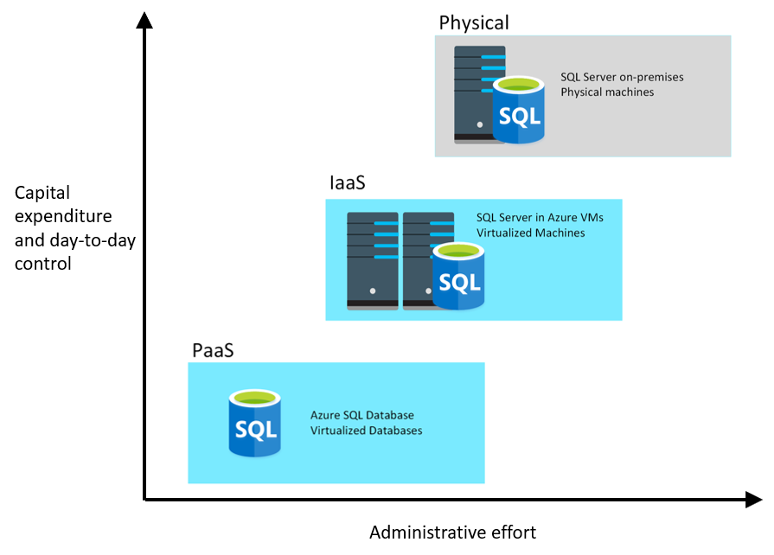
IaaS vs PaaS
Notes:
Instructor notes
Point out that if you don’t need the additional control, you can save on capital expenditure and administrative effort.
Talk through the points on the next 5 slides. All of the key points are on the slides.

Slide 7


SQL Server on Azure
SQL Server on Azure Virtual Machines
Azure SQL Managed Instance
Azure SQL Database
Infrastructure as a Service
Platform as a Service
Notes:
Azure offers a range of options for running SQL Server in the cloud.
For example, you can migrate your on-premises systems to a collection of Azure virtual machines. This approach still requires that you manage your DBMS carefully (SQL Server on Azure VM).
Alternatively, you can take advantage of the various Azure relational data services available. These data services manage the DBMS for you, leaving you free to concentrate on the data they contain and the applications that use them (Azure SQL Managed Instance and Azure SQL Database).

Slide 8



SQL Server on Azure Virtual Machines
SQL Server on Virtual Machines is an IaaS solution that enables users to use full versions of SQL Server in the Cloud without having to manage any on-premises hardware.
Guaranteed compatibility to SQL Server on premises
Customer manages everything – OS upgrades, software upgrades, backups, replication
Pay for the server and licensing, not per database

Slide 9
Azure SQL Database
Azure SQL Database is a PaaS offering where users create a managed database server in the cloud, and then deploy the databases on the server.
Low-cost option with minimal administration
Best for new cloud projects with flexible application design
Supports systems with variable loads – scale up and down quickly without restarting
Single Database
Elastic Pool
Create and run a database server in the cloud and access the database through the server.
Multiple databases share the same resources, such as memory, storage, and processing power.

Slide 10

Azure SQL Managed Instance
Azure SQL Managed Instance allows you to pre-provision compute resources and deploy several individual managed instances up to your pre-provisioned compute level.
Automatic backups, software patching, database monitoring, and other administrative tasks
Near 100% compatibility with on-premises SQL Server
Supported by other Azure services
Single Instance
Instance Pool
One SQL Server instance, multiple databases.
Multiple instances share the same resources.

Slide 11
Azure SQL Managed Instance or Azure SQL Database
Azure SQL Managed Instance
Azure SQL Database
Single instance:
SQL Server surface area (vast majority)
Native virtual network support
Fully managed service
Instance pool:
Pre-provision compute resources for migration
Enables cost-efficient migration
Ability to host smaller instances (2Vcore)
Currently in public preview
Single database:
Hyperscale storage (up to 100TB)
Serverless compute
Fully managed service
Elastic pool:
Resource sharing between multiple databases to price optimize
Simplified performance management for multiple databases
Fully managed service

Slide 12
PostgreSQL, MySQL, MariaDB
Azure Database for PostgreSQL is a relational database service in the Microsoft cloud based on the PostgreSQL Community Edition database engine.
Azure Database for MySQL is a PaaS implementation of MySQL in the Azure cloud, based on the MySQL Community Edition.
Azure Database for MariaDB is an implementation of the MariaDB database management system adapted to run in Azure. It's based on the MariaDB Community Edition.
Notes:
Instructor notes
PostgreSQL is a hybrid relational-object database. You can store data in relational tables, but a PostgreSQL database also enables you to store custom data types, with their own non-relational properties.
MySQL started life as a simple-to-use open-source database management system. It is the leading open source relational database for *Linux, Apache, MySQL, and PHP* (LAMP) stack apps.
MariaDB is a newer database management system, created by the original developers of MySQL. The database engine has since been rewritten and optimized to improve performance. MariaDB offers compatibility with Oracle Database (another popular commercial database management system).

Slide 13
Benefits of Azure Database for PostgreSQL, MySQL, MariaDB
Fully managed community database:
Take advantage of a fully managed service while still using the tools and languages you’re familiar with
Built-in high availability for lowest TCO:
Ensure your data is always available without the need for additional costs
Intelligent performance and scale:
Improve performance with built-in intelligence and up to 16TB storage and 20K IOPs
Industry-leading security and compliance:
Protect your data with enhanced security features including Advanced Threat Protection
Integration with the Azure ecosystem:
Build apps faster with Azure services and safeguard your innovation with Azure IP Advantage
Notes:
Instructor notes
Point out that you get these benefits because of Azure. For example, Azure Database for MySQL is based on the Community edition, which does not have high availability, but Azure Database for MySQL has high availability because it runs in Azure.

Slide 14
Lesson 1: Knowledge check (continued on next slide)
Which deployment requires the fewest changes when migrating an existing SQL Server on-premises solution?
Azure SQL Database Managed Instance
SQL Server running on a virtual machine
Azure SQL Database Single Database
Which of the following statements is true about SQL Server running on a virtual machine?
You must install and maintain the software for the database management system yourself, but backups are automated
Software installation and maintenance are automated, but you must do your own backups
You’re responsible for all software installation and maintenance, and performing back ups
Which of the following statement is true about Azure SQL Database?
Scaling up doesn’t take effect until you restart the database
Scaling out doesn’t take effect until you restart the database
Scaling up or out will take effect without restarting the SQL database

Slide 15
Lesson 1: Knowledge check (continued)
When using an Azure SQL Database managed instance, what is the simplest way to implement backups?
Manual Configuration of the SQL server
Create a scheduled task to back up
Backups are automatically handled
What is the best way to transfer the data in a PostgreSQL database running on-premises into a database running Azure Database for PostgreSQL service?
Export the data from the on-premises database and import it manually into the database running in Azure
Upload a PostgreSQL database backup file to the database running in Azure
Use the Azure Database Migration Services

Slide 16
Lesson 2: Explore provisioning and deploying relational database services in Azure

Slide 17
Lesson 2 objectives
Provision relational data services
Configure relational data services
Explore basic connectivity issues
Explore data security
Notes:
Instructor notes
Ensure that all of your students fully understand the components and processes involved. This will be the focus of the module.

Slide 18

Demo: What is provisioning?
This video summarizes the process that Azure performs when you provision a service
Notes:
Instructor notes
NOTE: this demo is duplicated in Module 3 Lesson 2 so only demo once.
Link: https://www.microsoft.com/videoplayer/embed/RE4zTud

Slide 19
Configure relational data services
Basics
Network connectivity
Additional settings
Tags (DB)
Review & create
Subscription
Resource group
Managed Instance/ Server name
Database Name (DB)
Admin Login
Password
Region
Opt-in for pools (DB)
Compute + storage
Public vs Private access
VNet/Firewall rules
Connection type (MI)
Data source (DB)
Server Collation (MI)
Database Collation (DB)
Time zone (MI)
Opt-in for Advanced data security (DB)
Terms and Privacy
Notes:
Instructor notes
For a production deployment, you should consider all settings for every deployment.

Slide 20
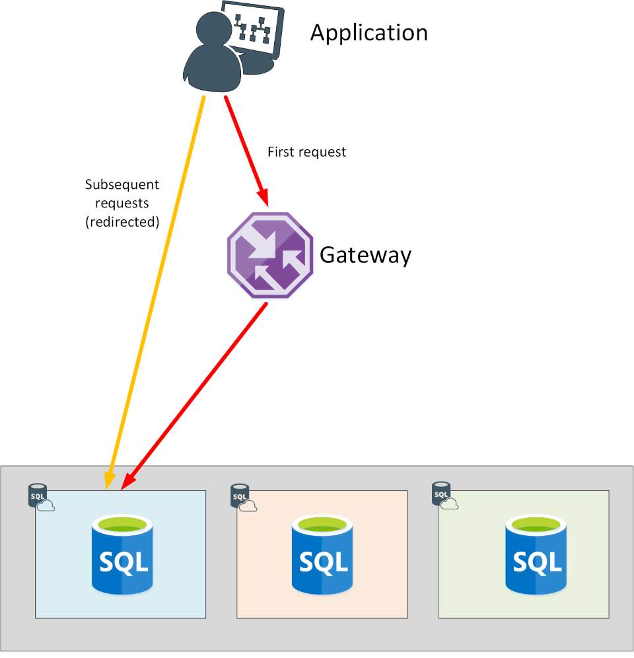
Connectivity from within Azure
Policy of Redirect
An application establishes a connection to the Azure SQL database through the gateway
All requests after the first, will go directly to the database
If connectivity to the database fails, the application will have to reconnect through the gateway.
The application may be directed to a different copy of the database running on another server in the cluster.
Notes:
Instructor notes
https://docs.microsoft.com/en-us/azure/sql-database/sql-database-connectivity-architecture

Slide 21
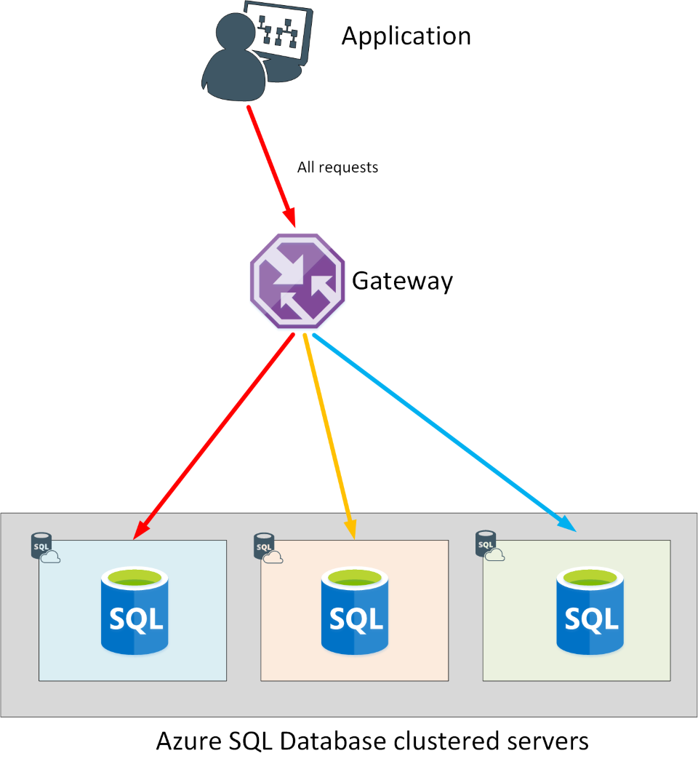
Connectivity from outside of Azure
Policy of Proxy
An application establishes a connection to the Azure SQL database via the gateway
All requests will go through the gateway
The application may be directed to a different copy of the database running on another server in the cluster.

Slide 22
Authentication and Access Control
“Mixed Mode” authentication forced
SQL Auth for deployment: server admin:
Server-level principal for logical server for DB
Member of sysadmin server role for MI
Need Windows Auth? Use Azure AD Authentication Azure Managed Instance:
Azure AD Server Admin
SQL or Azure AD Logins
Database Users
SQL Server Contained Database supported
Azure SQL Database:
Azure AD Server Admin
SQL logins
loginmanager and dbmanager roles for limited server admins
Database Users
Contained Database Users including Azure AD (recommended)

Slide 23
Azure Role Based Access Control (RBAC)
Azure Role Based Access Control (RBAC) helps you manage who has access to Azure resources, and what they can do with those resources.
You control access to resources using role assignments. A role assignment consists of three elements:
Security principal: an object that represents a user or service that is requesting access to Azure resource
Role: a collection of permissions
Scope: A lists the set of resources that the access applies to
Notes:
SQL DB Contributor – Can create and manage database but access the database (Ex. to connect and read data)
SQL Managed Instance Contributor – Create and manage managed instances but can't give access to others.
SQL Security Manager - Manage security policies for MI and databases (like auditing) but not access the MI or database
SQL Server Contributor – Manage servers and databases but not access them.

Slide 24
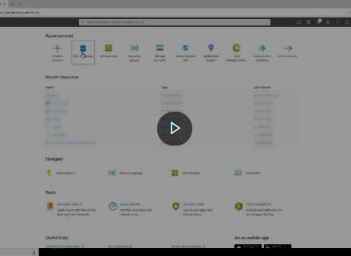
Demo: Provision an Azure SQL Database instance
This video demonstrates how to provision an Azure SQL Database instance, to create a database and server
Notes:
Link: https://www.microsoft.com/videoplayer/embed/RE4AkhG

Slide 25
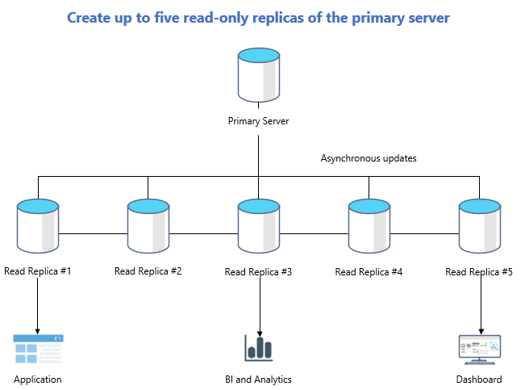
Azure DB – Read replicas
Read replicas help improve performance and scale of read-intensive workloads such as BI and analytics
Consider the read replica features in scenarios when delays in synching data between the primary and replicas are acceptable
Create a replica in a different Azure region from the primary for a disaster recovery plan, where a replica replaces the primary in cases of regional disasters
Data storage on replica servers grows automatically without impacting workloads

Slide 26
Lab: Provision Azure relational database service
As part of your role at Contoso as a data engineer, you’ve been asked to create and configure SQL Server, PostgreSQL, and MySQL servers for Azure
Go to the exercise Provision non-relational Azure data services module on Microsoft Learn, and follow the instructions in the module to create data stores
Notes:
Link: https://docs.microsoft.com/en-us/learn/modules/explore-provision-deploy-relational-database-offerings-azure/7-exercise-provision-relational-azure-data-services?pivots=postgresql
Create data stores:
A Cosmos DB for holding information about the volume of items in stock. You need to store current and historic information about volume levels, so you can track how levels vary over time. The data is recorded daily.
A Data Lake store for holding production and quality data.
A blob container for holding images of the products the company manufactures.
File storage for sharing reports.

Slide 27
Lesson 3: Query relational data in Azure

Slide 28
Lesson 3 objectives
Query relational data
Describe query techniques for data using the SQL language
Notes:
Instructor notes
Ensure that all of your students fully understand the components and processes involved. This will be the focus of the module.

Slide 29
Introduction to SQL
SQL is a standard language for use with relational databases
SQL standards are maintained by ANSI and ISO
Proprietary RDBMS systems have their own extensions of SQL such as T-SQL, PL/SQL, pgSQL

Slide 30
SQL Statement types
DML
DDL
DCL
Data Manipulation Language
Used to query and manipulate data
SELECT, INSERT, UPDATE, DELETE
Data Definition Language
Used to define database objects
CREATE, ALTER, DROP, RENAME
Data Control Language
Used to manage security permissions
GRANT, REVOKE, DENY
Notes:
Instructor notes
Explain that DML statements are by far the most common.

Slide 31
Use DML statements
Statement | Description
SELECT | Select/read from a table
INSERT | Insert new rows in a table
UPDATE | Edit/Update existing rows in a table
DELETE | Delete existing rows in a table
Notes:
Instructor notes

Slide 32
Elements of the SELECT Statement
Clause | Expression
SELECT | <select list>
FROM | <table or view>
WHERE | <search condition>
GROUP BY | <group by list>
ORDER BY | <order by list>
Notes:
Instructor notes
Explain that SQL is not procedural. It processes the FROM first, followed by WHERE, GROUP BY, ORDER BY, and finally SELECT.
20761C
3: Writing SELECT Queries

Slide 33
Example of SELECT statement
SELECT EmployeeId, YEAR(OrderDate) AS OrderYear
FROM Sales.Orders
WHERE CustomerId = 71
GROUP BY EmployeeId, YEAR(OrderDate)
HAVING COUNT(*) > 1
ORDER BY EmployeeId, OrderYear;

Slide 34
Example of INSERT statement
The INSERT ... VALUES statement inserts a new row
INSERT INTO Sales.OrderDetails
(orderid, productid, unitprice, qty, discount)
VALUES (10255,39,18,2,0.05);
Table and row constructors add multirow capability to INSERT ... VALUES
INSERT INTO Sales.OrderDetails
(orderid, productid, unitprice, qty, discount)
VALUES
(10256,39,18,2,0.05),
(10258,39,18,5,0.10);
Notes:
Instructor notes
Note that some words are optional and you might see the word INTO omitted.
20761C
7: Using DML to Modify Data

Slide 35
Use DDL statements
Statement | Description
CREATE | Create a new object in the database, such as a table or a view
ALTER | Modify the structure of an object. For instance, altering a table to add a new column.
DROP | Remove an object from the database.
RENAME | Rename an existing object.
Notes:
Instructor notes
You use DDL statements to create, modify, and remove tables and other objects in a database (table, stored procedures, views, and so on).
These are the most common DDL statements: CREATE ALTER, DROP, and RENAME.
WARNING: The DROP statement is very powerful. When you drop a table, all the rows in that table are lost. Unless you have a backup, you won't be able to retrieve this data.

Slide 36
Example of CREATE statement
CREATE TABLE Mytable
(Mycolumn1 int NOT NULL PRIMARY KEY, Mycolumn2 VARCHAR(50) NOT NULL , Mycolumn3 VARCHAR(10) NOT NULL

Slide 37
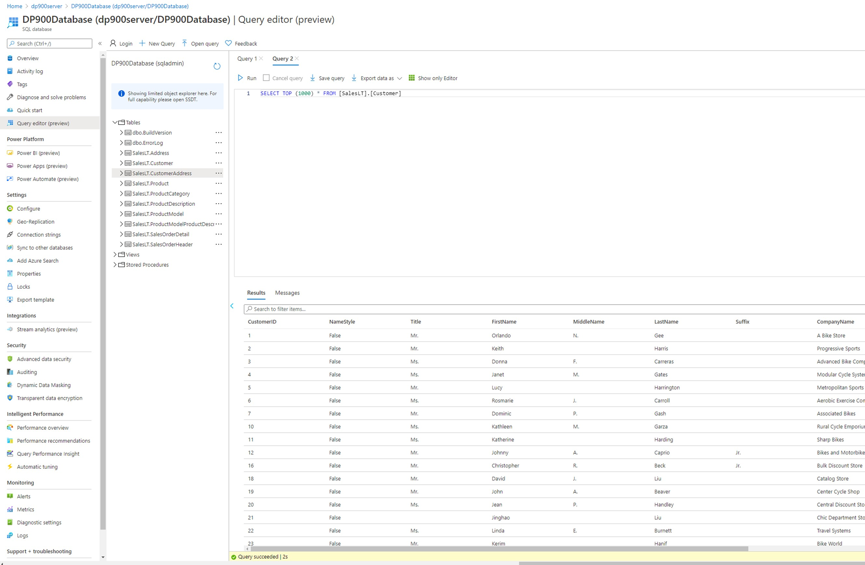
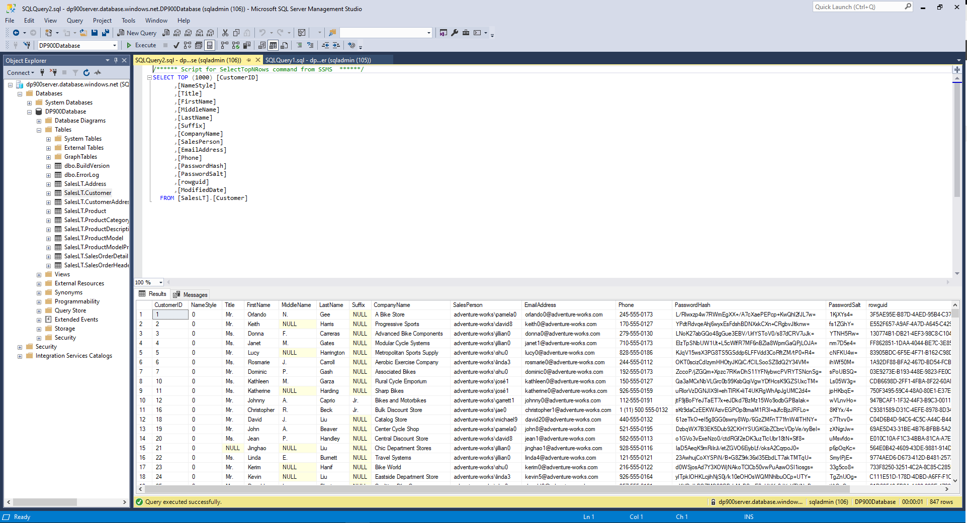
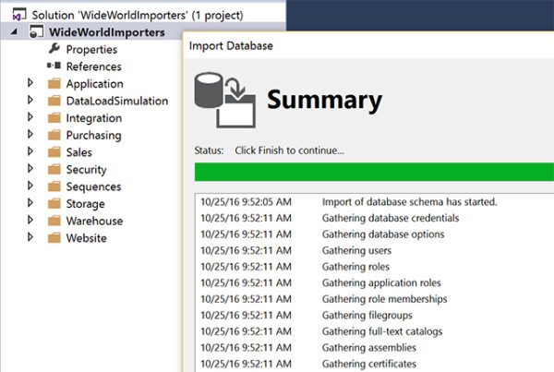
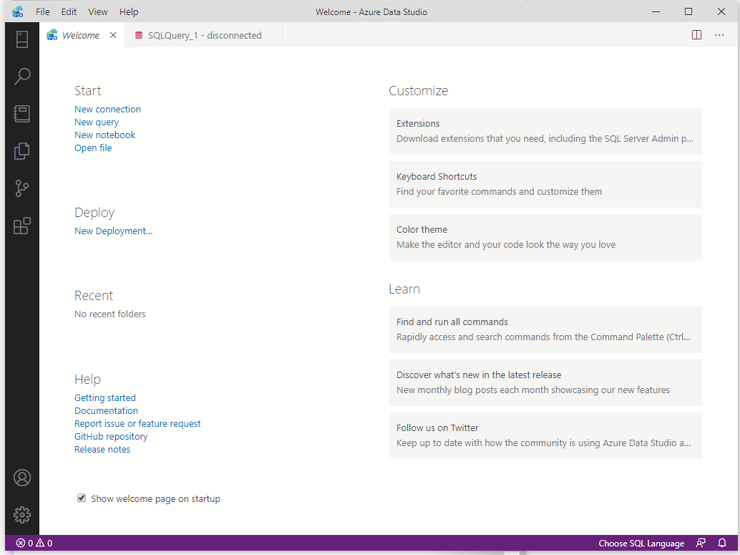
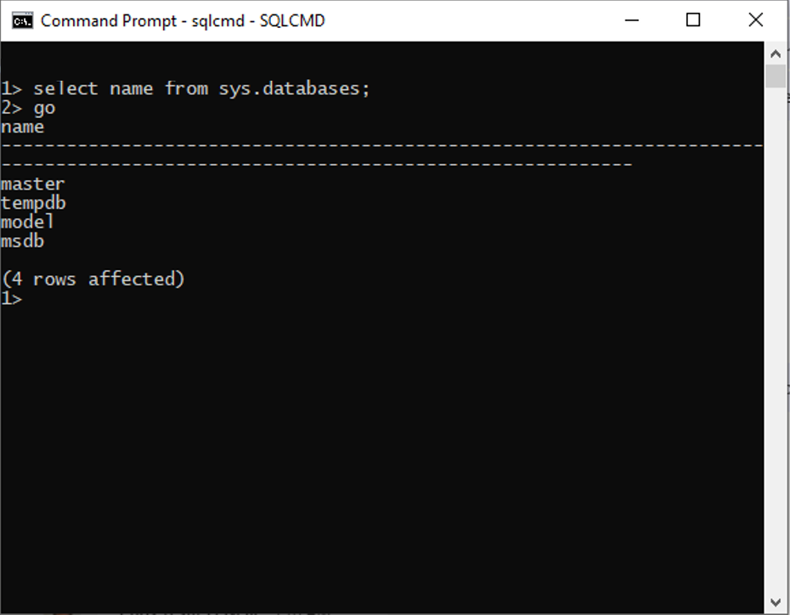
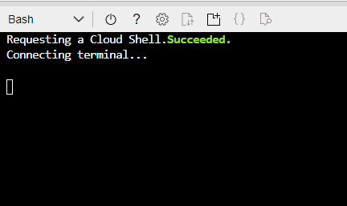
Query tools
Azure portal
SQL Management Studio
SQL Server Data Tools
Azure Data Studio
SQLCMD
Azure CLI/Cloud Shell
Notes:
Instructor notes
These are all tools that will accept SQL statements.

Slide 38
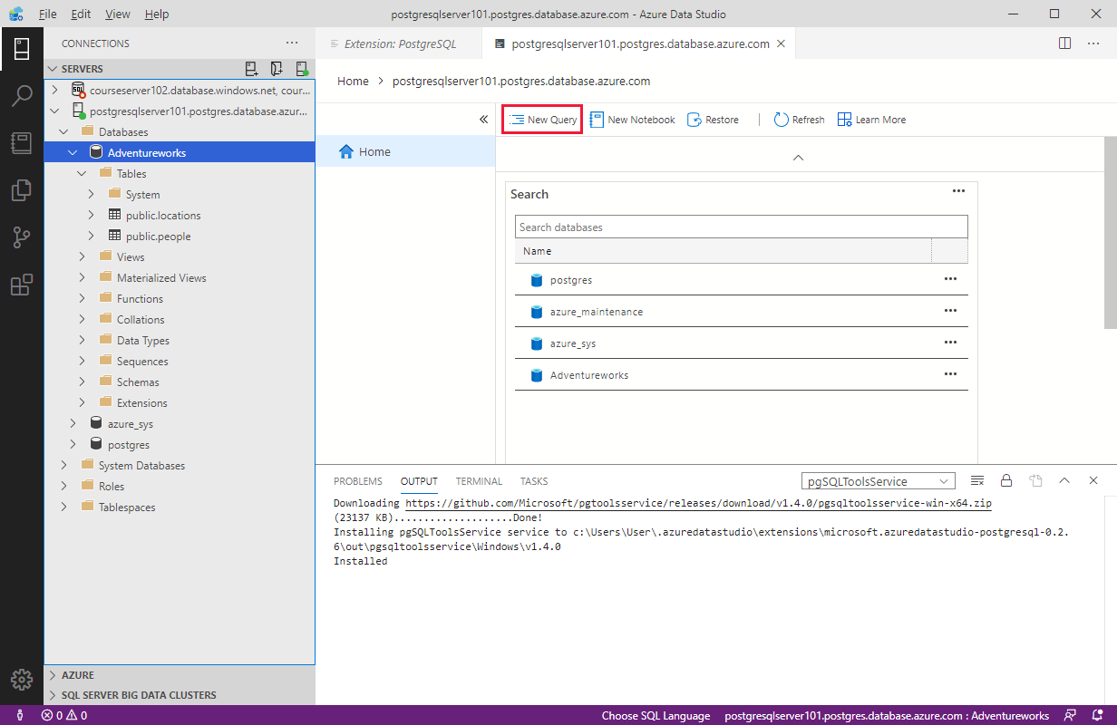
Query relational data in Azure Database for PostgreSQL
Use PSQL to query a database
Azure Cloud Shell
Azure Data Studio
psql --host=<server-name>.postgres.database.azure.com --username=<admin-user>@<server-name> --dbname=postgres
CREATE DATABASE "Adventureworks";
CREATE TABLE PEOPLE(NAME TEXT NOT NULL, AGE INT NOT NULL);
INSERT INTO PEOPLE(NAME, AGE) VALUES ('Bob', 35);
INSERT INTO PEOPLE(NAME, AGE) VALUES ('Sarah', 28);
CREATE TABLE LOCATIONS(CITY TEXT NOT NULL, STATE TEXT NOT NULL);
INSERT INTO LOCATIONS(CITY, STATE) VALUES ('New York', 'NY’);
INSERT INTO LOCATIONS(CITY, STATE) VALUES ('Flint', 'MI');
SELECT * FROM PEOPLE;
SELECT * FROM LOCATIONS;
Notes:
Instructor notes
Note that, while SQL Server uses TSQL, PostgreSQL uses psql. It is similar, but not the same.

Slide 39
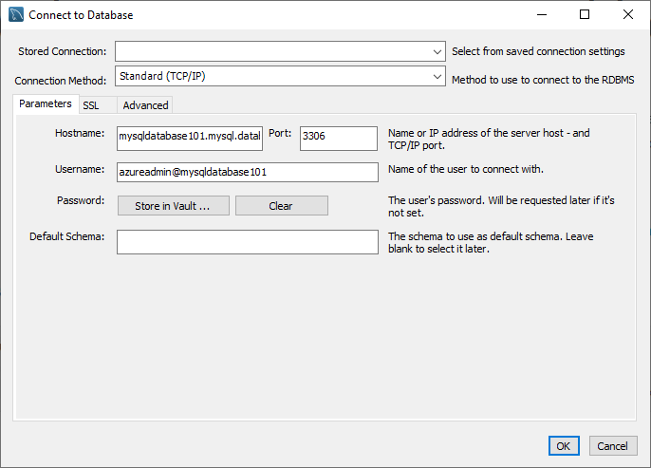
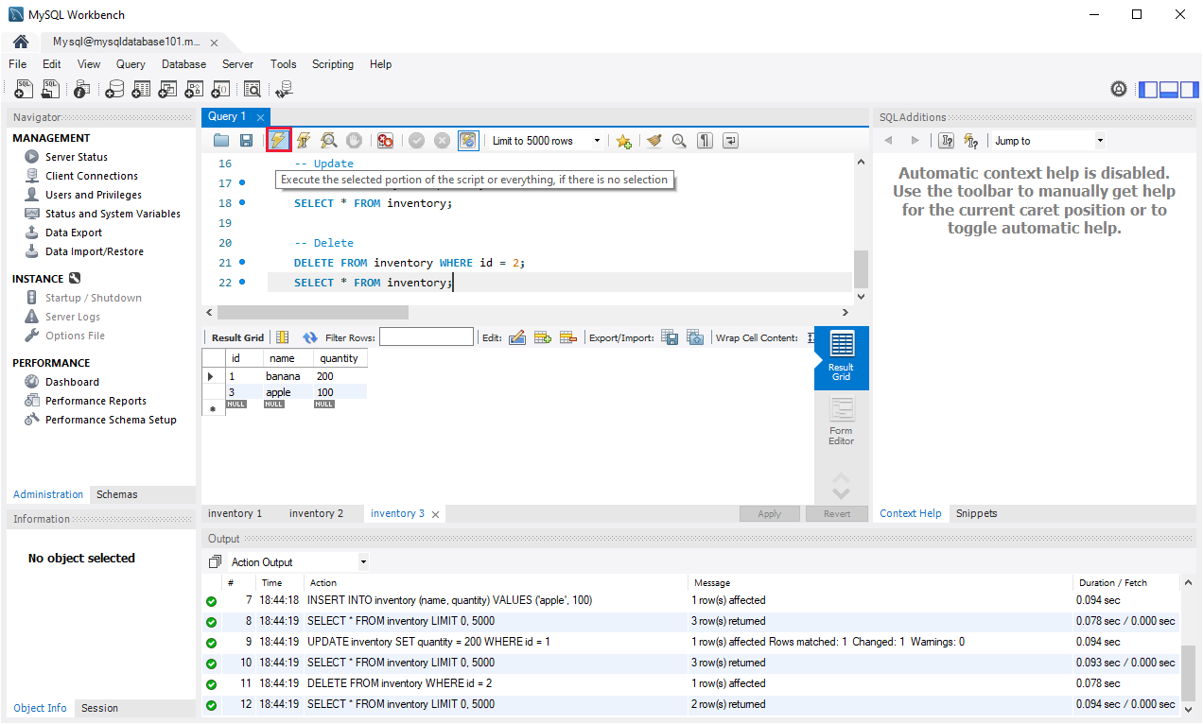
Query relational data in Azure Database for MySQL
Use MySQL Workbench to query a database

Slide 40
Lab: Use SQL to query Azure SQL Database
Contoso has provisioned the SQL database and has imported all the inventory data into the data store. As lead developer, you’ve been asked to run some queries over the data
Go to the exercise Use SQL to query Azure SQL Database module on Microsoft Learn, and follow the instructions to query the database to find how many products are in the database, and the number of items in stock for a particular product
Notes:
Link: https://docs.microsoft.com/en-us/learn/modules/query-relational-data/6-perform-query

Slide 41
Closing slide

